Slide 1
Serverless: Beyond the Cloud
Ali Kanso, Alaa Youssef
Presented by: Ali Kanso, PhD
Senior Cloud SW Engineer
IBM Research
T.j. Waston, NY
USA

Slide 2
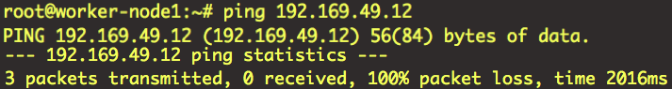

Can we Execute Everything in the Cloud?
Sadly, no!
Even in a serverless world, servers exist
Cloud computers are still computers

Slide 3

The “Unfrequented” SW
Installation hassle
Probably will sit idle for weeks
May install unwelcomed dependencies (compromised packages)
Will occupy disk space (maybe CPU, Mem, …)
Removal hassle, (may leave residues)

Slide 4
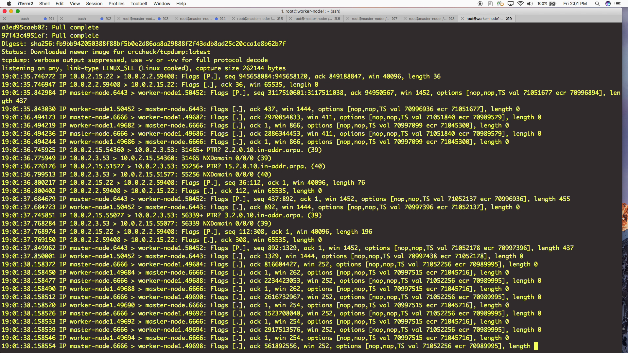
How About a Different Approach

Slide 5
The Serverless Shell
start
Request received
SW installed?
Execute command
yes
Container image exists
No
Perform traditional deployment
Run in Isolation: secure
Resource Bounded
Automatic upgrades
Cross Platform
Easy to install
Easy to cleanup
Container still running?
Pass command to container
yes
Search registry for existing images of the needed program and run container with received cmd args
Cleanup (when needed)
end

Slide 6
The Serverless Shell Architecture
Users
Commands to images mapping
Docker containers
Docker containers
Image-registry (local or remote)
Serverless Shell
Docker-engine
Linux Operating System

Slide 7
Time Analysis
Execution time
Command received
Image loaded
Command executed
time
Command processed
Container instantiated
Setup time

Slide 8
Are We Consuming More or Less Resources?
Resource Saving
Major loss region
ε
0
ε = (MTBC – (MTTS + MTTE))
MTBC: Mean Time Between Calls
MTTS: Mean Time To Setup
MTTE: Mean Time To Execute

Slide 9
How Can Optimize? Caching!
Pattern Recognition
Temporal
Sequencing

Slide 10
Conclusion
Serverless does not have to be just a Cloud technology
It can be a mindset, that we can apply on any device or platform

Slide 11
Questions?
Are we done installing SW??

